Slide 3
Workshop
git clone https://github.com/petereijgermans11/workshop-jhipster

Slide 4
What Is JHipster?
=
+
/
Notes:
JHipster is a development platform to generate, develop and deploy Spring Boot + Angular/React Web applications and Spring microservices.

Slide 5

Yeoman
= Generator for Jhipster

Slide 6
Goal JHipster
To generate for you a complete Web app or microservice, unifying:
Frontend: Angular, React
Backend: Spring Boot

Slide 7
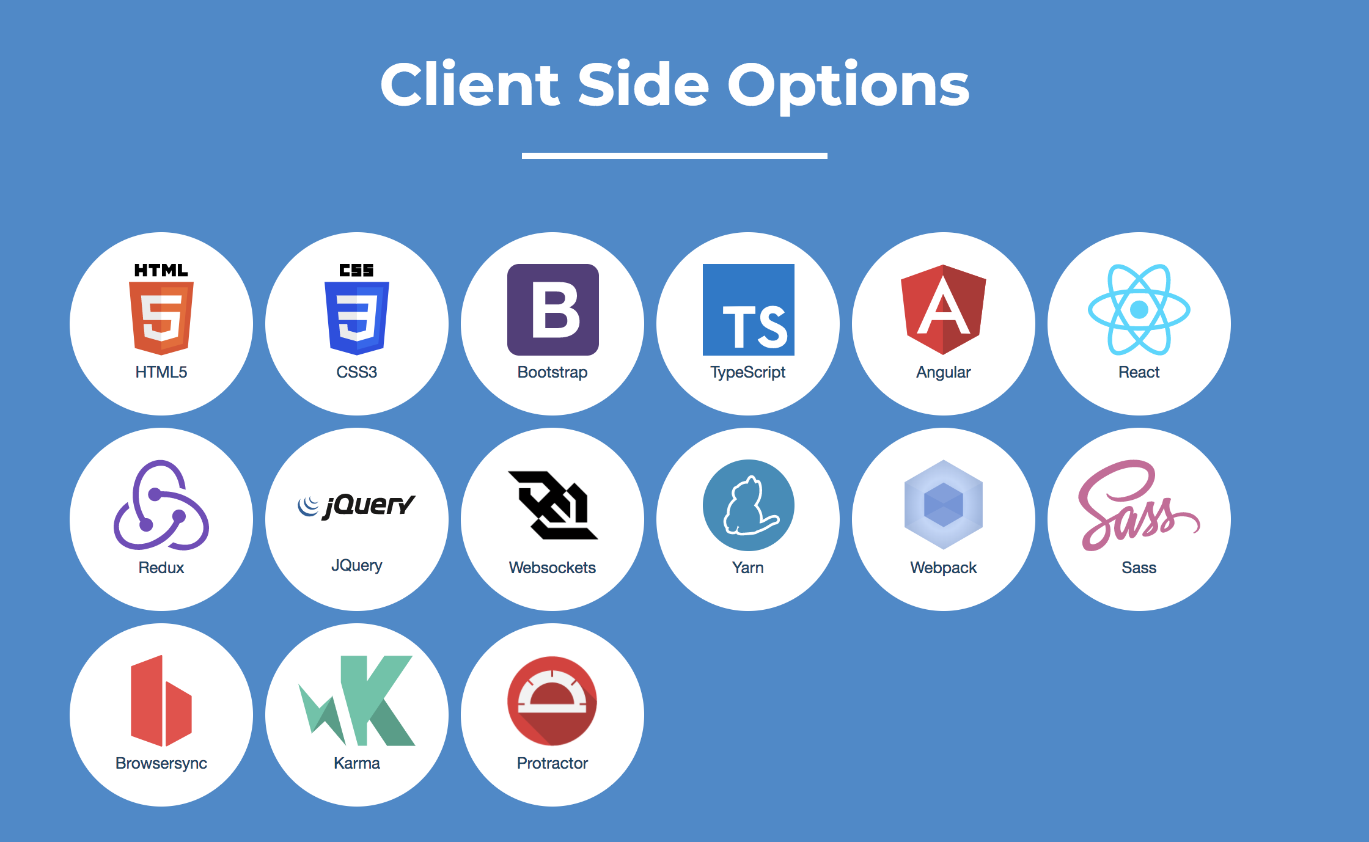

Slide 8
Webpack
MODULE BUNDLER FOR frontend
Notes:
Compiles, minifies, optimizes the front-end

Slide 9

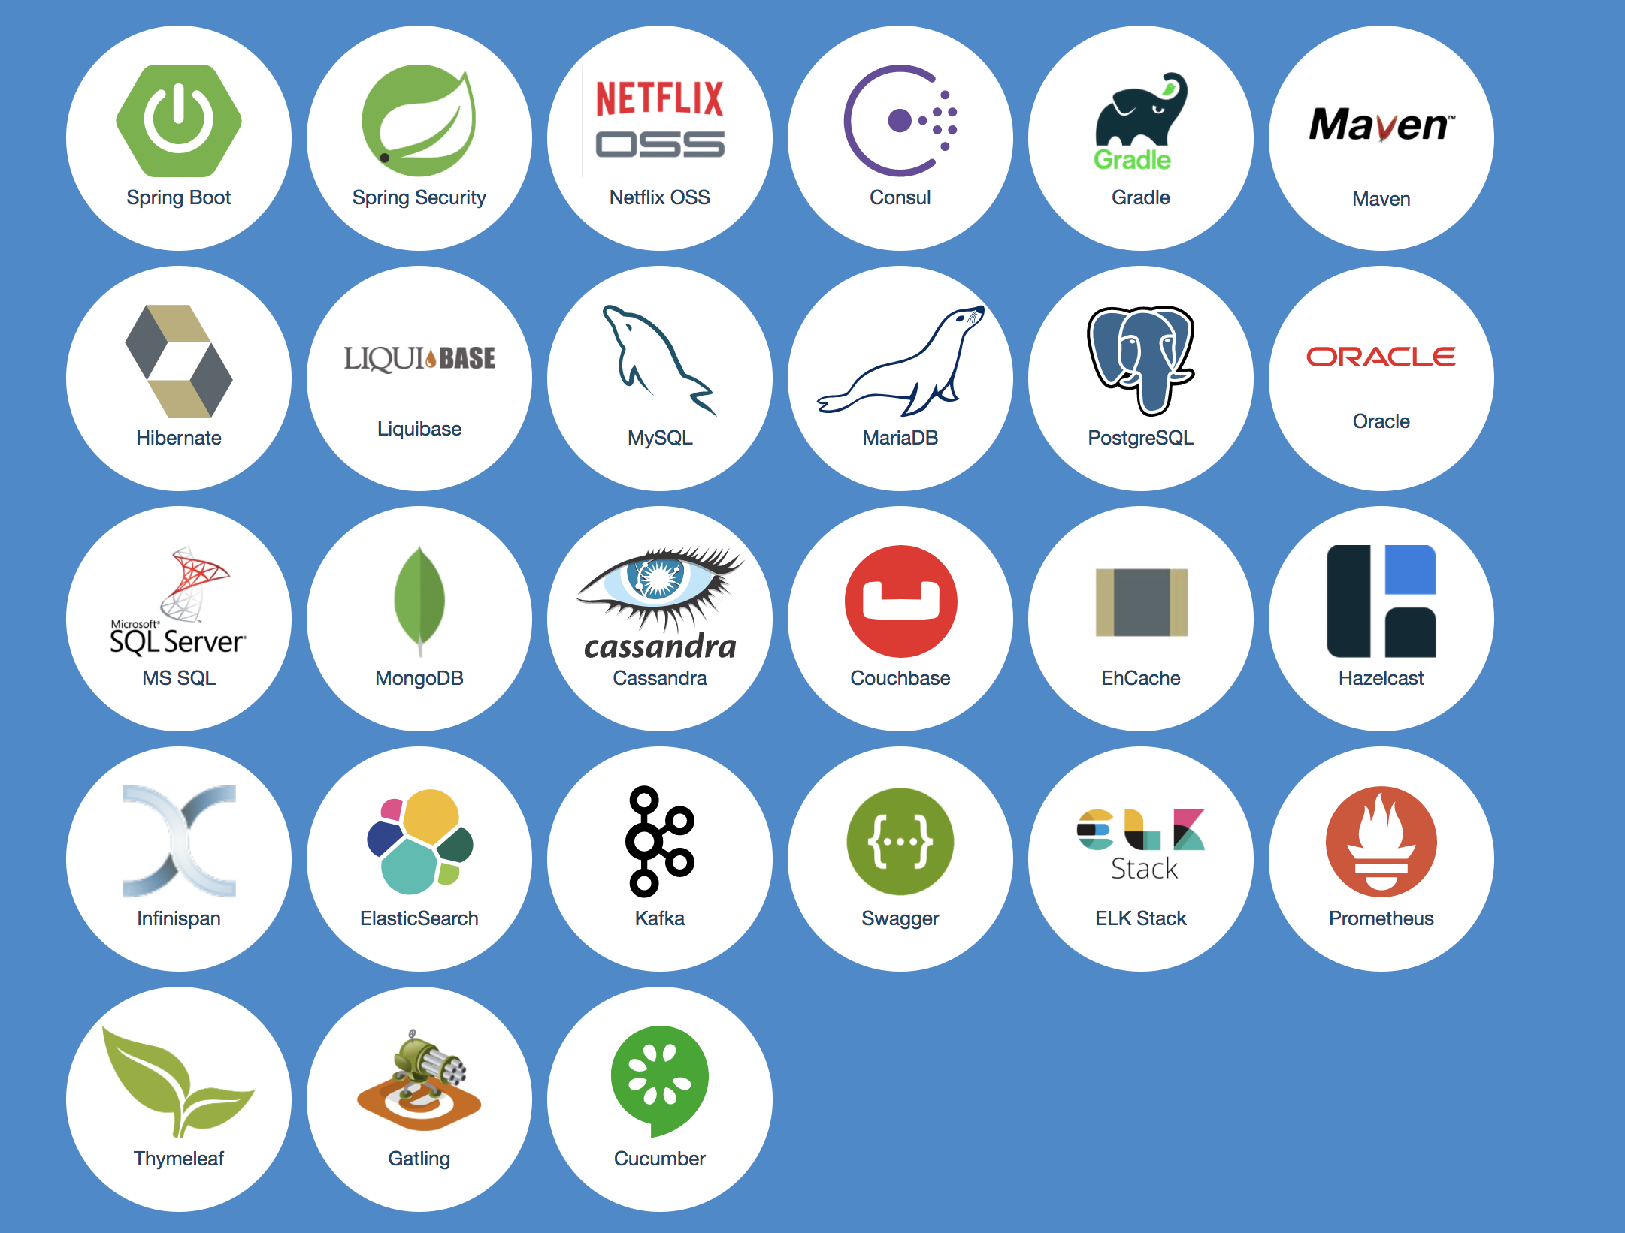
Notes:
Spring Boot: Stand alone Spring app out-of-the-box. Embedded Tomcat server
Netfix OSS: Microservices: used for the Gateway en Registry en Circuit breaker
Consul: Service Discovery
Gradle/Maven: Compileren en builden van een WAR/EAR/JAR. (inclusief unittesten applicatie)
Hibernate/JPA: Hibernate zorgt voor de koppeling van Java-klassen aan databasetabellen
Liquibase: is a library for tracking, managing and applying database schema changes.
EhCache/Hazelcast: http://www.ehcache.org/documentation/2.7/get-started/introduction.html

Slide 10
Spring Boot
SPRING IS THE STANDARD FOR JAVA APPS !!!
Abstractions to ease application coding
Out-of-the-box configuration
@Service
public class UserService {
@Autowired private UserRepository userRepository;
}

Slide 11
Spring Security
Secures URLs and Java code (Spring Beans)
Stateful security solutions (cookies)
Stateless security solutions (OAuth2/JWT)

Slide 12
Notes:
Cookie based authentication is stateful. This means that an authentication record or session must be kept both server and client-side. The server needs to keep track of active sessions in a database, while on the front-end a cookie is created that holds a session identifier.
Token-based authentication is stateless. The server does not keep a record of which users are logged in or which JWTs have been issued. Instead, every request to the server is accompanied by a token which the server uses to verify the authenticity of the request.
https://auth0.com/blog/cookies-vs-tokens-definitive-guide/
Store Data in the JWT
With a cookie based approach, you simply store the session id in a cookie in the databse.
JWT's on the other hand allow you to store any type of metadata, as long as it's valid JSON.
Performance
When using the cookie based authentication, the back-end has to do a lookup in de database, whether that be a traditional SQL database or a NoSQL alternative, and the roundtrip is likely to take longer compared to decoding a token. Additionally, since you can store additional data inside the JWT, such as the users permission level, you can save yourself additional lookup calls to get and process the requested data.
Mobile Ready
Native mobile platforms and cookies do not mix well. JWT mix well with Native mobile platforms.

Slide 13
Spring MVC REST
THE BEST REST FRAMEWORK IN JAVA
@RestController
public class AccountResource {
@PostMapping("/account")
public void saveAccount(@RequestBody UserDTO userDTO) { userService.updateUserInformation(userDTO);
}
}

Slide 14
Maven / Gradle
THE MOST POPULAR JAVA BUILD TOOLS
Notes:
Maven gebruikt een "Project Object Model" (POM) om het softwareontwikkeltraject te sturen. In de POM staan verder de afhankelijkheden met andere modules en componenten, waaruit de volgorde van bouwen bepaald wordt. In de POM kunnen naast de gebruikelijke stappen als compileren en samenvoegen voor distributie, extra acties gedefinieerd worden die het ontwikkelproces kunnen ondersteunen. Voorbeelden hiervan zijn automatisch testen, (statische) codeverificatie en analyse van "Code Coverage" door de testen.

Slide 17
JPA
JPA IS THE STANDARD ORM SOLUTION FOR JAVA
Hibernate is used underneath
Notes:
Hibernate/JPA: Hibernate zorgt voor de koppeling van Java-klassen aan databasetabellen

Slide 18
@Entity
@Table(name = "user_table")
public class User {
@Id
private Long id;
@Column(name = ”login_name")
private String login;
@Column(name = "password_hash")
private String password;
@Column(name = "first_name")
private String firstName;

Slide 19
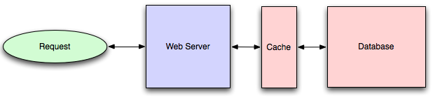
EhCache / Hazelcast

Slide 20
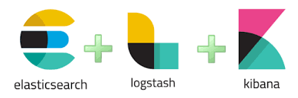
ELK stack
Notes:
Elasticsearch provides the storage and analytics engine
Logstash acts as a collection and transformation agent
Kibana helps you visualize the data that you have

Slide 21
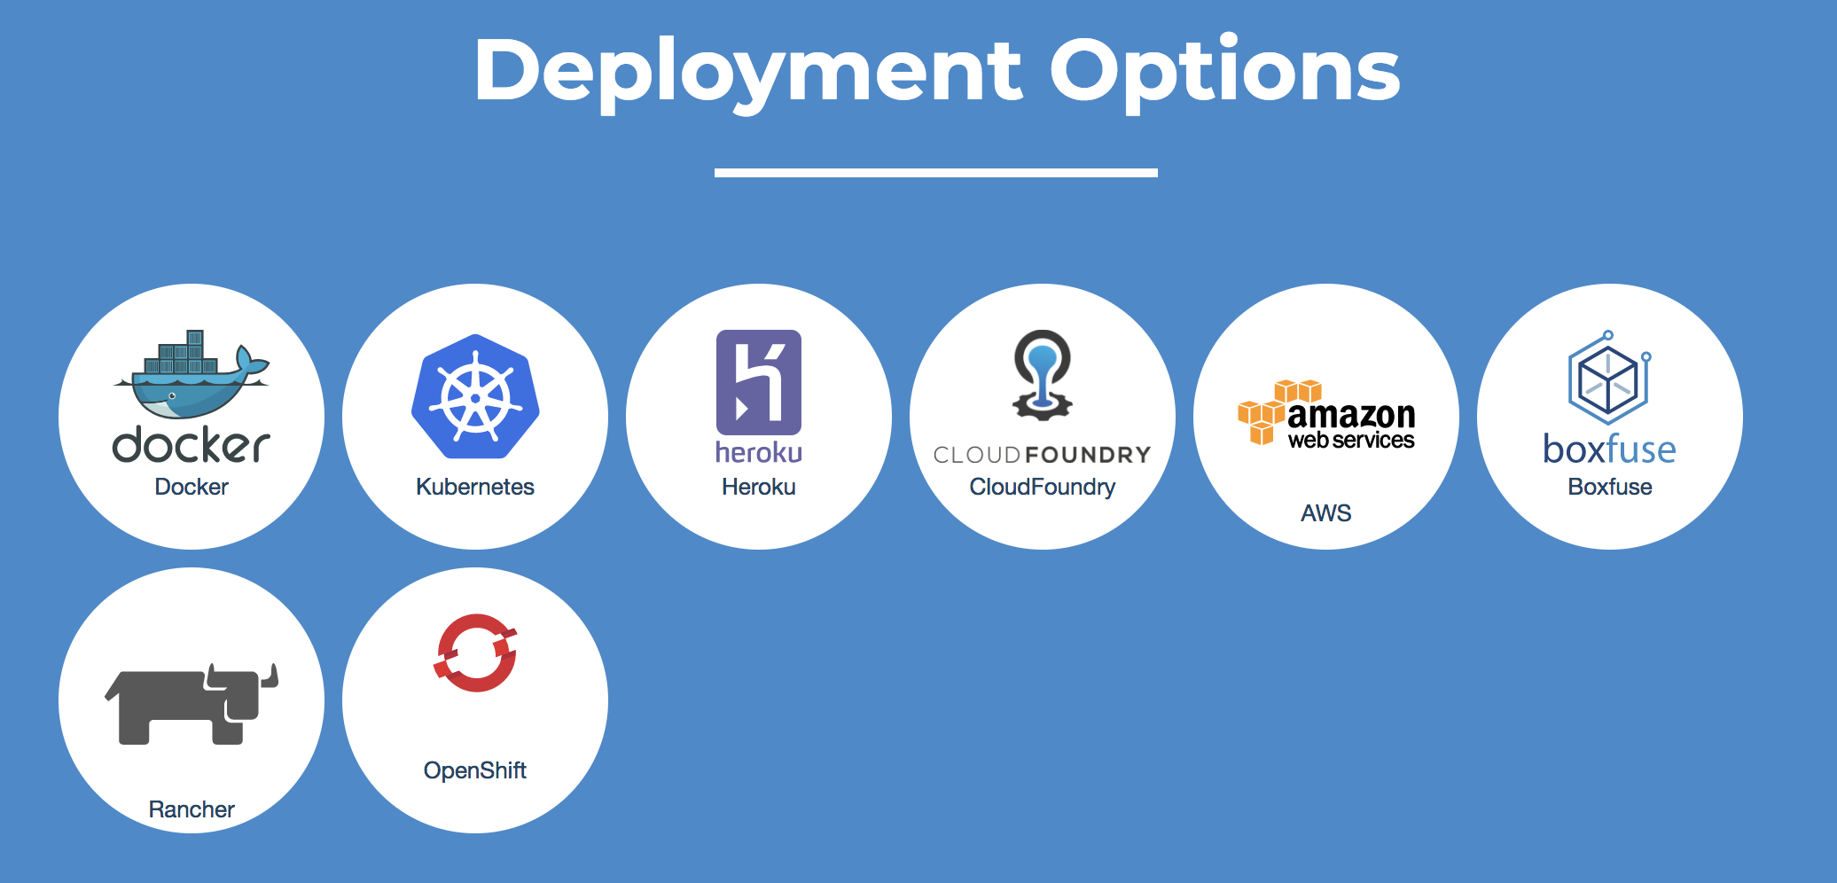
Notes:
Docker: verpakt een applicatie in een container. Zo wordt het installeren van een applicatie op een server even eenvoudig als het installeren van een mobiele app op je tablet of smartphone.
Kubernetes: for AUTOMATING deployment and scaling of containerized applications[
\

Slide 22
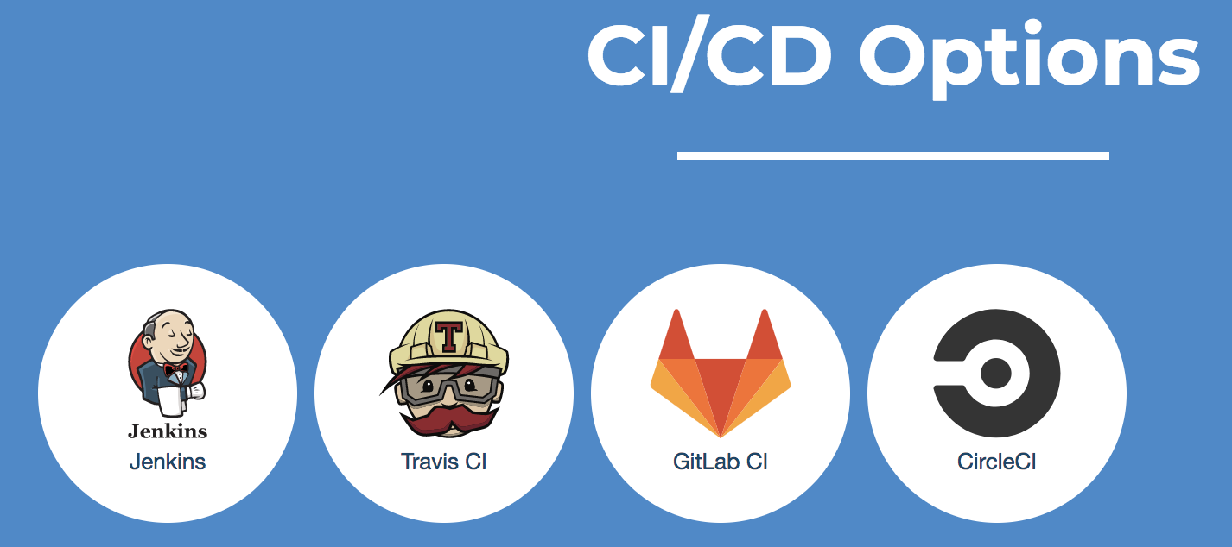
Notes:
Jenkins: for building, deploying and automating any project.

Slide 23
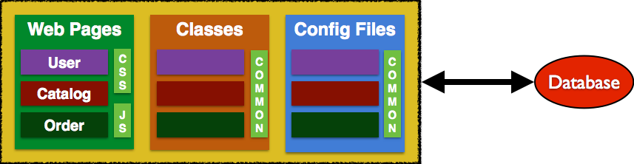
Monolith

Slide 24
Exercise: JHipster Quick Start
Install JDK 8 (see Oracle)
Install Git
Install Node (https://nodejs.org/en/)
Install Yarn (https://yarnpkg.com/lang/en/)
Install Yeoman - npm install -g yo
Install JHipster - npm install -g generator-jhipster

Slide 25
Exercise: Generate a Monolith
http://www.baeldung.com/jhipster

Slide 26
What is generated?
A monolith:
Angular / ReactJS
Spring Boot + + JPA/Hibernate
Notes:
Spring: Framework, Java, Alternatief JEE
Spring Boot: Stand alone Spring app out-of-the-box. Embedded Tomcat server
Maven: Compileren en builden van een WAR/EAR/JAR. (inclusief unittesten applicatie)
Hibernate: Hibernate zorgt voor de koppeling van Java-klassen aan databasetabellen

Slide 27
Exercise: Start the application
Terminal
Run your Spring Boot backend application:
./mvnw
Open in browser
http://localhost:8080
Notes:
Terminal 2
Start your Webpack development frontend server with:
yarn start

Slide 28
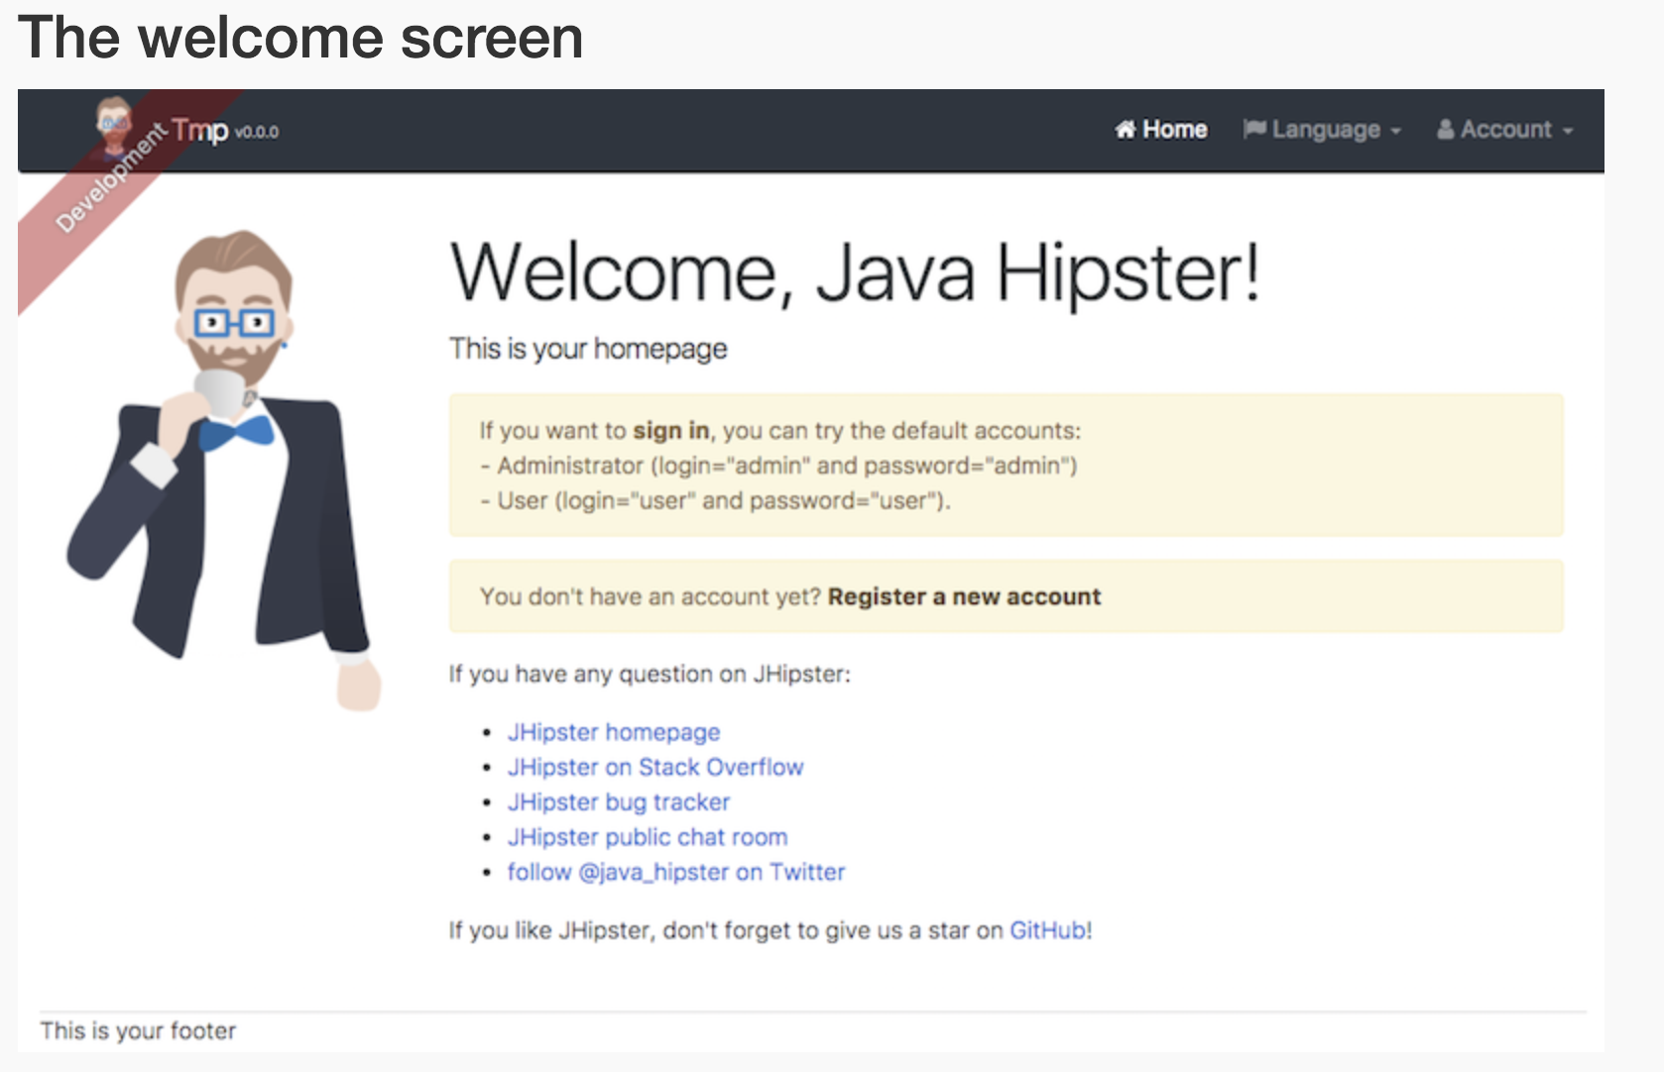

Slide 29
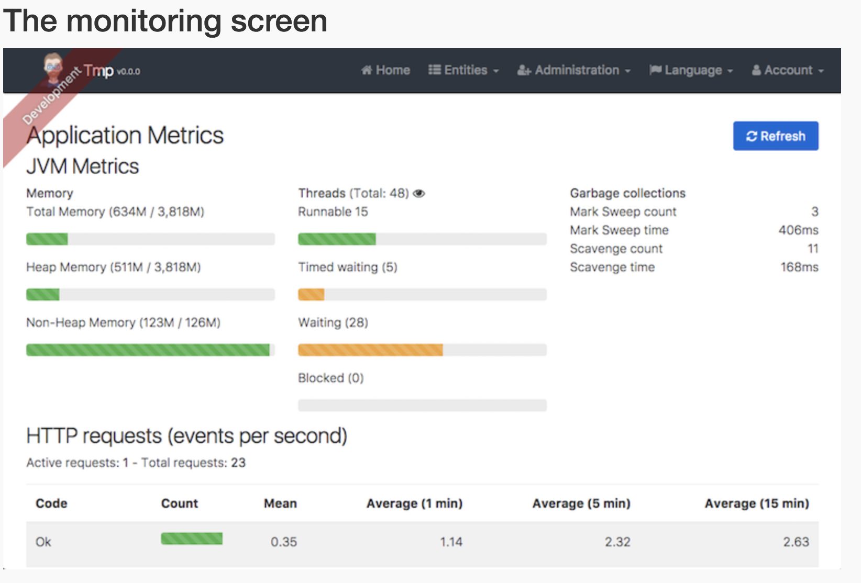

Slide 30
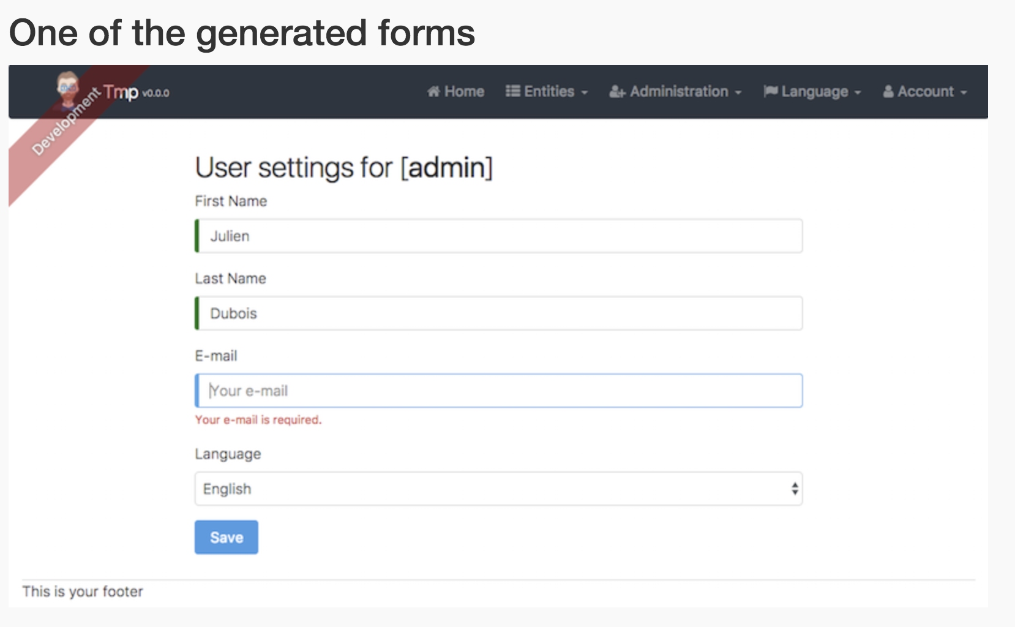

Slide 31
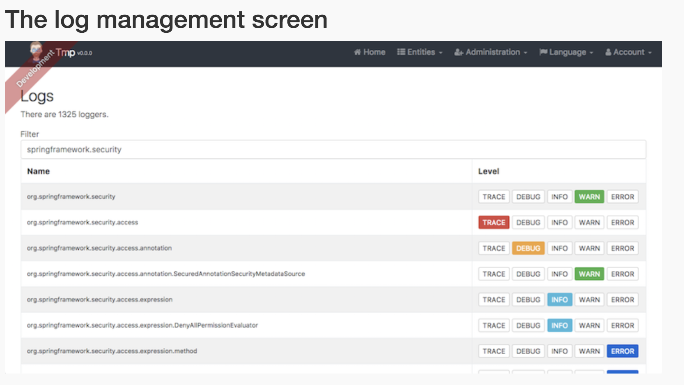

Slide 32
Microservices architecture

Slide 33
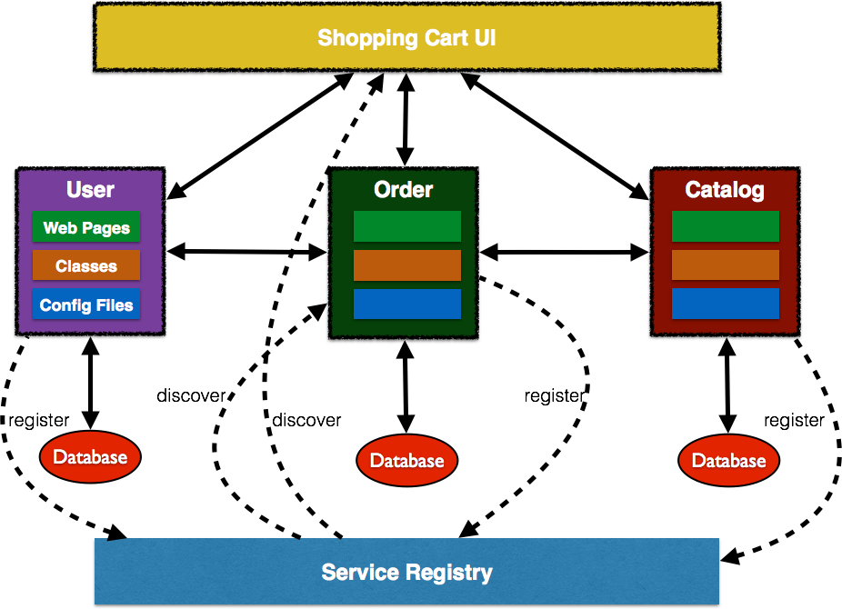
→ API GateWay
Notes:
Many people have the wrong idea about microservices. Microservices aren't telling you to break your project down based on the tier, such as JMS, UI, logging, etc. No this is absolutely not.
We need to break it down by function. A complete function and its functionality may consist of UI, business, logging, JMS, data access, JNDI lookup service, etc.
API Gateway :
All requests from clients first go through the API Gateway. It then routes requests to the appropriate microservice. The API Gateway will often handle a request by invoking multiple microservices and aggregating the results. It can translate between web protocols such as HTTP and WebSocket and web-unfriendly protocols that are used internally like MQ or Thrift binary RPC.
An API Gateway is a server that is the single entry point into the system (Facade pattern: Facade shields the user from the complex details of the system and provides them with a simplified view)
- is responsible for request routing, composition, and protocol translation.
- Aggregates results
- can also provide each client with a custom API.
- can also mask failures in the backend services by returning cached or default data
- Other responsibilities: authentication, monitoring, load balancing, caching, request shaping and management, and static response handling.
-----
The fallacies of distributed computing are a set of assertions describing false assumptions that programmers new to distributed applications invariably make.

Slide 35
Netflix OSS
NETFLIX OSS PROVIDES GREAT TOOLS FOR MICROSERVICES
Netflix OSS Gateway
Netflix OSS Service registry
Notes:
Eureka - Service registry for load balancing and failover.
Zuul - Proxy for dynamic routing, monitoring and security
Ribbon - software load balancing for services

Slide 36
Exercise: JHipster with a Microservice Architecture

